Slide 1
Kris Kandarpa MD PhD

Slide 2
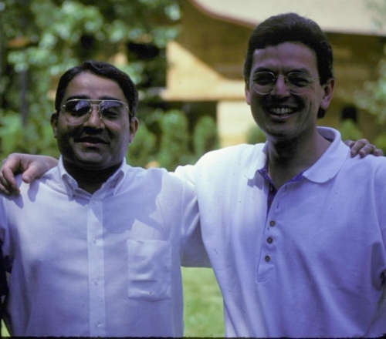
Notes:
57401 1990

Slide 4
Blood Flow
Notes:
Blood Flow

Slide 5
You name it – He has done it
MD PhD
Chief Resident Chief IR
Classical Academic Papers Books etc par excellence
Device development
Book Author and Innumerable Publications
Chairman U Mass
CMO Device Company
National Profile NIH
Photography Artist World Traveler
Gardener

Slide 6
Invited Lectures: World Wide 369
Original Peer-reviewed Reports: 63
Scientific Exhibits: 20
Books 18 Japanese Korean Chinese Turkish Spanish Russian
Reviews 17
Book Chapters 16
Electronic and Video Media Publications 8
Inventions and Original Designs 3
MRI coil /heated stents/ device for thrombolysis
… other Patents (6)/ Intellectual property creation (4)

Slide 7
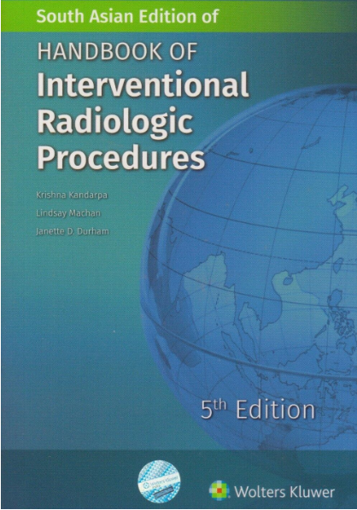
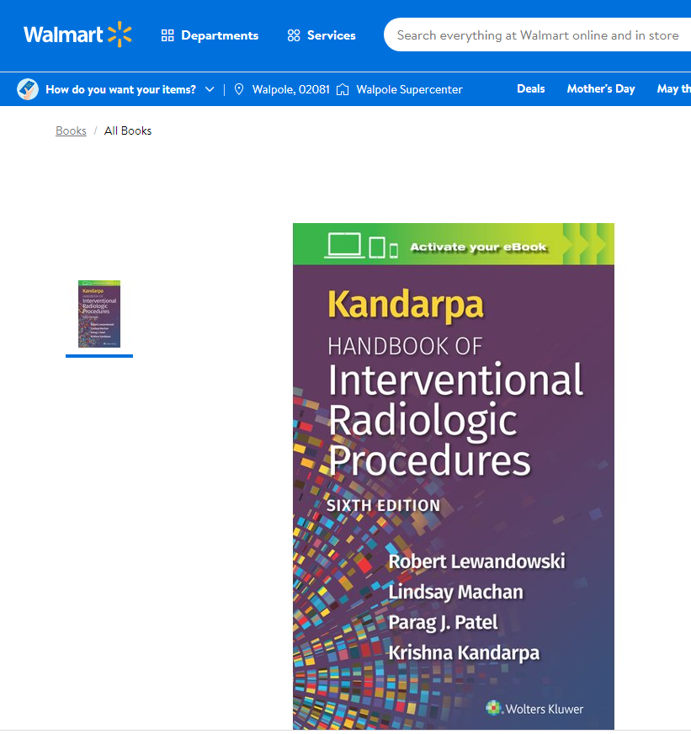
6th edition is to be released in May 2023,
translated into 6 foreign languages

Slide 8
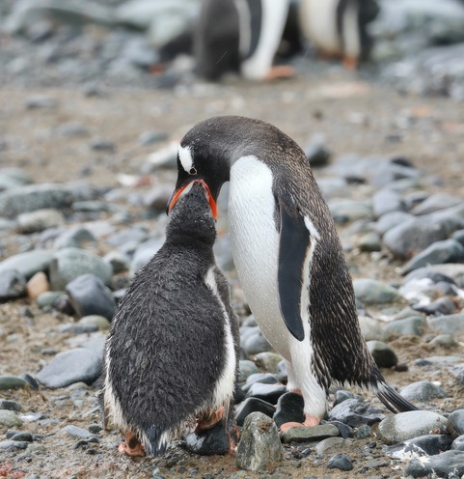
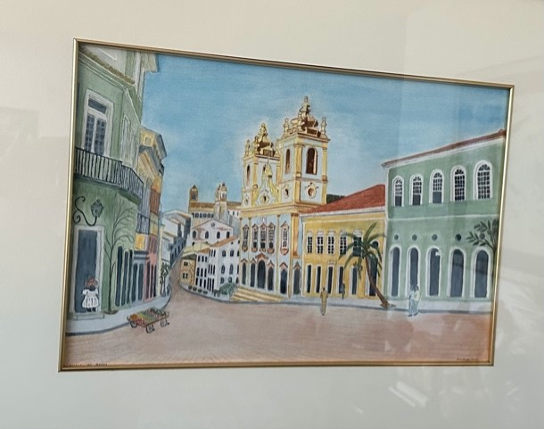
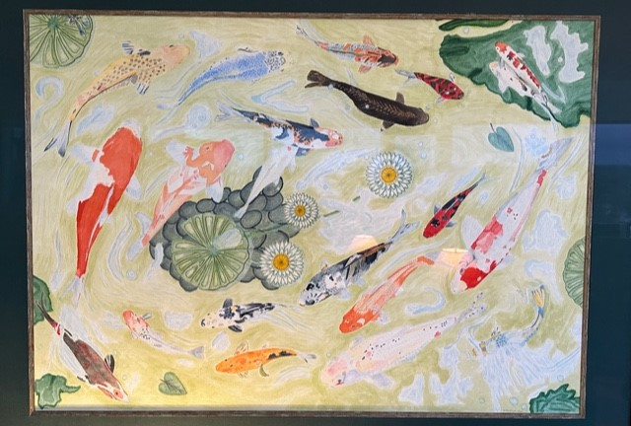

Slide 9
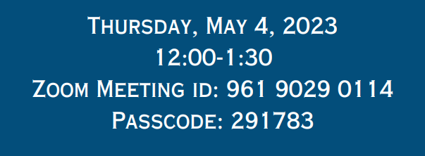
Dr Kris Kandarpa
"Use of AI in Radiology"

